Slide 1
Transport Management System
Daniel Mihalev, 11G
1

Slide 2
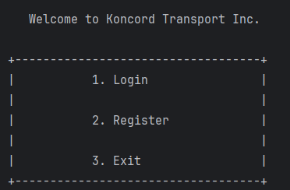
Purpose
.

Slide 3
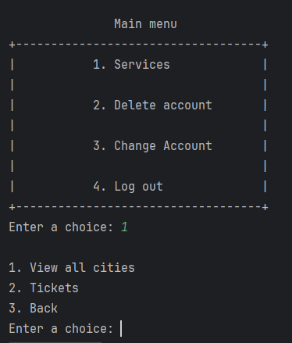
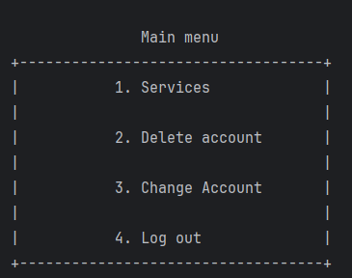
Purpose
.
.
.
.
.
3

Slide 4







Used technologies
.
.
.
.
.
4

Slide 5
Let’s move on to the project!
.
.
.
.
.
5

